Slide 1

CO2 emission
Ram Pakanayev & Michelle Chorny

Slide 2

Our research question
Prediction of CO2 emission - in mega tones
by countries in 2019

Slide 3

Why we choose this topic?
We find the climate change situation very important, so we decided to do our research on CO2 emission. Carbon emissions such as CO2 raise global temperatures by trapping solar energy in the atmosphere. This alters:
water supplies and weather patterns
changes the growing season for food crops
threatens coastal communities with increasing sea levels.
Heat
trapped

Slide 4

About the project
In our project we gathered data about the CO2 emission of 77 countries all over the world from 1990 till 2019.
Our main goal was to predict the CO2 emission in 2019.

Slide 5
Part of our features
CO2 Total Mt-
CO2 emission in mega tones
Generation GWh-
amount of electricity produced in 1B\hour
consumption GWh- consumption of electricity
installed capacity MW-
maximum of electricity that cand be produced
Renewable installed capacity MW- maximum of electricity that cand be produced from renewable
Renewable generation GWh-
comes from natural sources or processes that are constantly replenished.

Slide 6

Data Acquisition

Slide 7

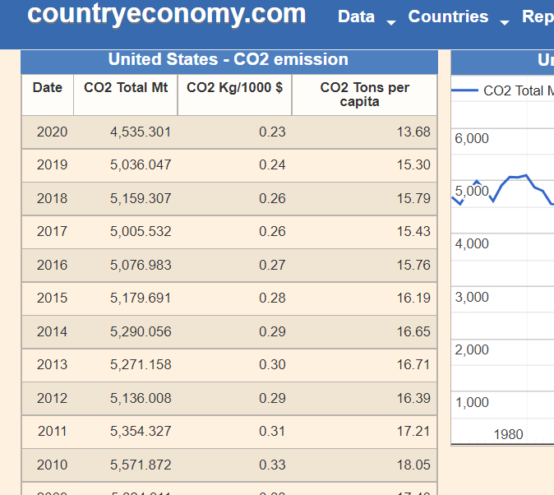
Crawling
The method we used to extract the data is by using ‘BeautifulSoup’ library to crawl the relevant records. With our crawler we scraped tables of CO2 emission, electricity consumption, population and more by countries per years from the countryeconomy website.
Data Acquisition
Data Cleaning
EDA
Machine Learning
Conclusions

Slide 8
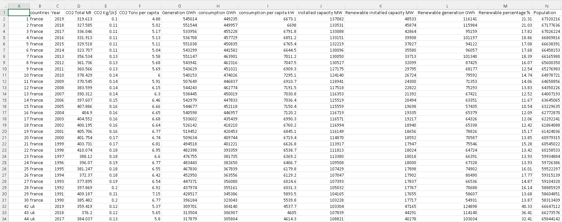
Crawling
Finally we saved all the records into a dataframe called ‘Big Table Final’.
Data Acquisition
Data Cleaning
EDA
Machine Learning
Conclusions

Slide 9

Data Cleaning

Slide 10
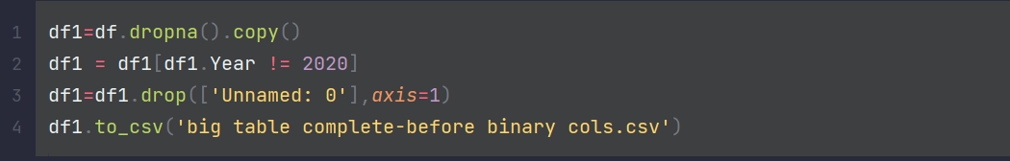
Data cleaning:
After crawling our data we started cleaning it. We noticed that there were too many rows with too many missing values in the years before 1990 so we decided to drop those rows. In edition, we also dropped the data from 2020.
Data Acquisition
Data Cleaning
EDA
Machine Learning
Conclusions

Slide 11
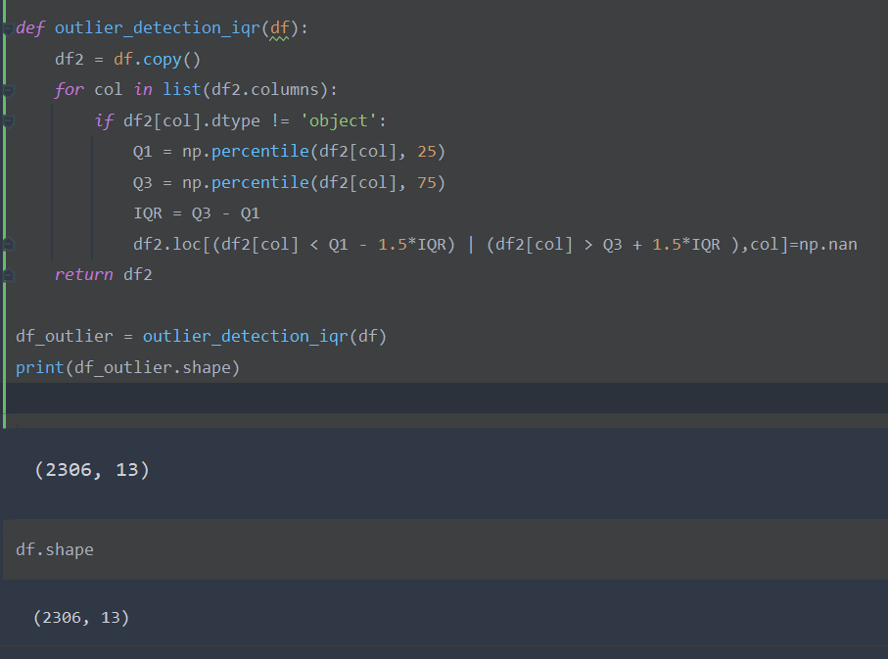
Outliers
As you can see we have no outliers.
Data Acquisition
Data Cleaning
EDA
Machine Learning
Conclusions

Slide 12

EDA Exploratory data analysis

Slide 13
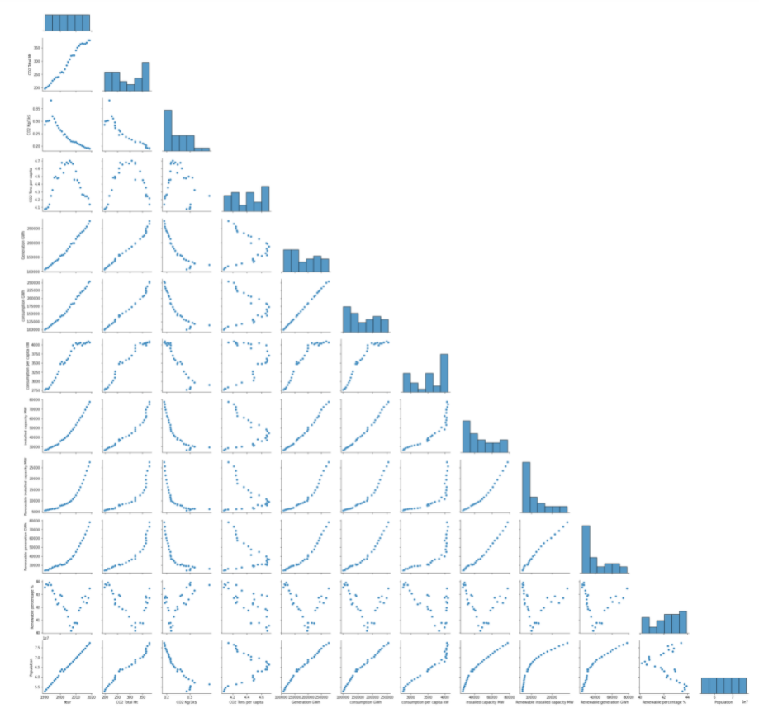
EDA questions:
Energy consumption vs CO2 emission
Energy consumption vs population
Heat map
Data Acquisition
Data Cleaning
EDA
Machine Learning
Conclusions

Slide 14

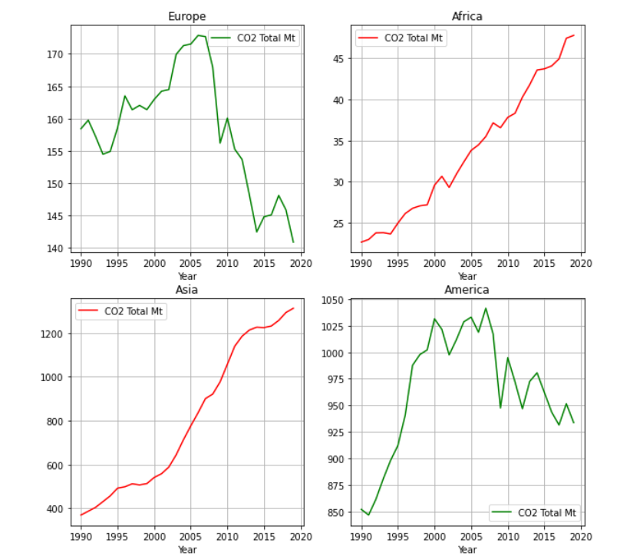
Co2
emission
Per
continents
Data Acquisition
Data Cleaning
EDA
Machine Learning
Conclusions

Slide 15
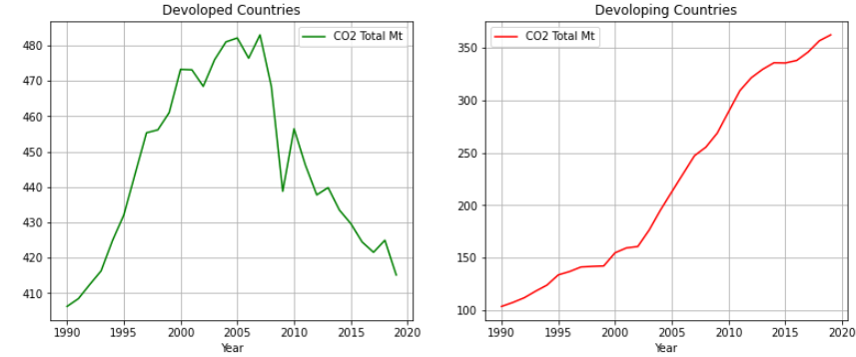
Developed VS Developing
___
___
Countries
Data Acquisition
Data Cleaning
EDA
Machine Learning
Conclusions

Slide 16
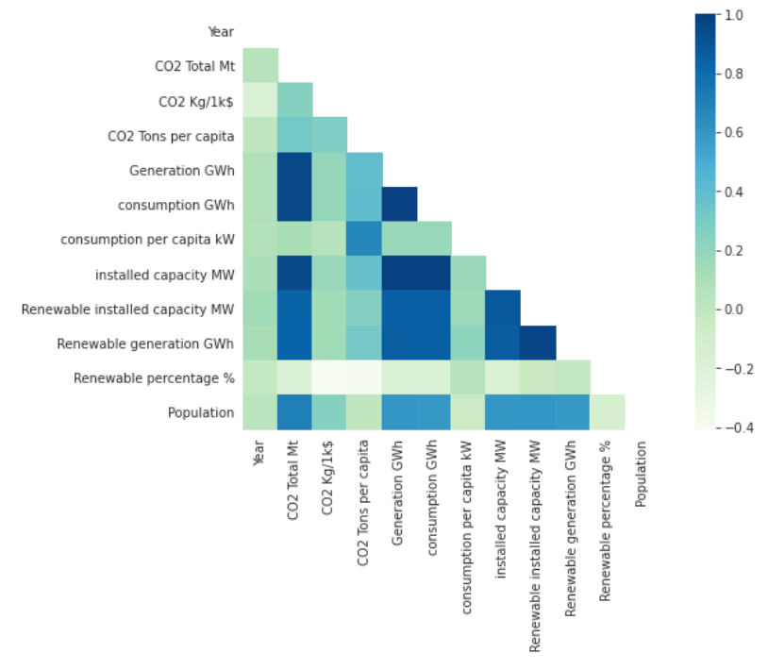
Heatmap of correlations
Data Acquisition
Data Cleaning
EDA
Machine Learning
Conclusions

Slide 17
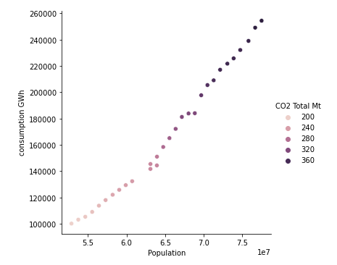
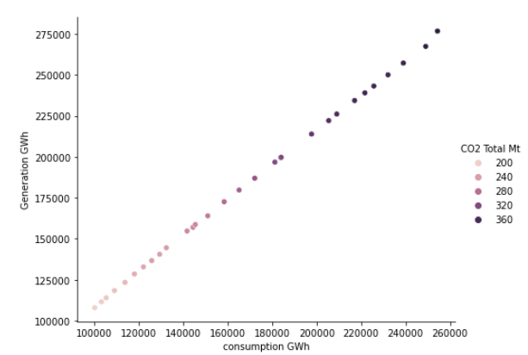
Data Acquisition
Data Cleaning
EDA
Machine Learning
Conclusions

Slide 18
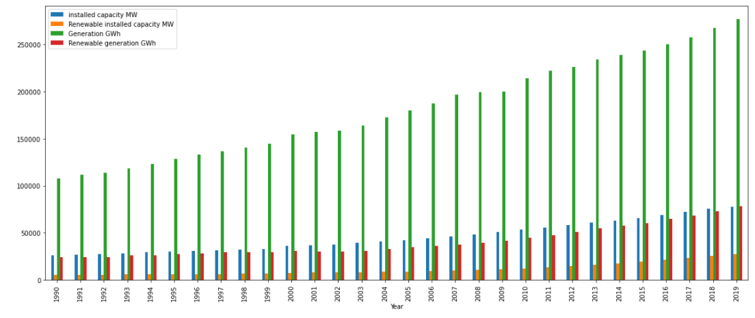
Data Acquisition
Data Cleaning
EDA
Machine Learning
Conclusions

Slide 19
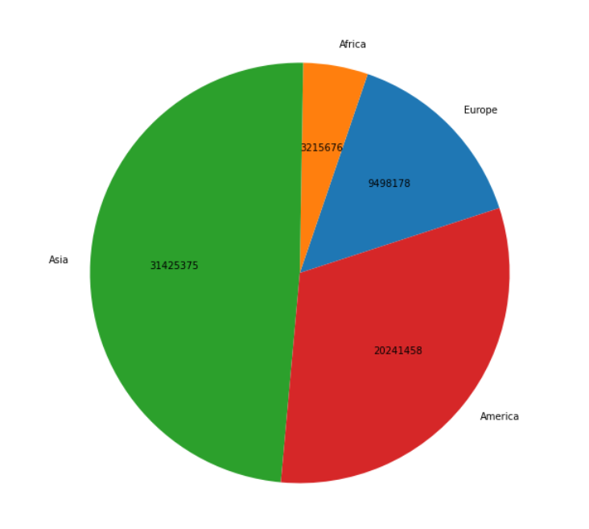
Cumulative CO2 emission
in mega tones per continents
Data Acquisition
Data Cleaning
EDA
Machine Learning
Conclusions
From 1990 till 2019

Slide 20
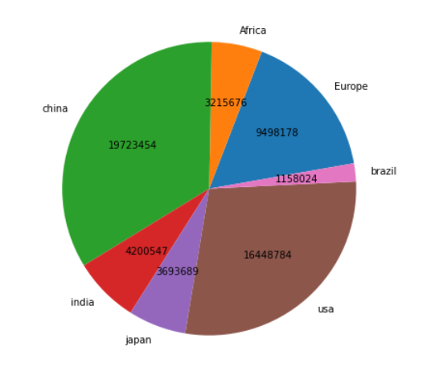
Cumulative CO2 emission
in mega tones
Data Acquisition
Data Cleaning
EDA
Machine Learning
Conclusions
From 1990 till 2019

Slide 21

Machine Learning

Slide 22
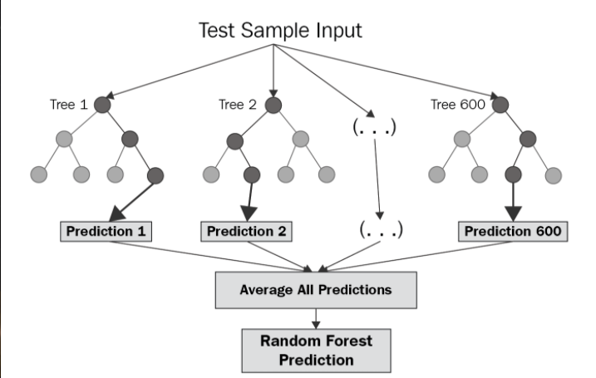
Random forest regression
Random Forest Regression is a supervised learning algorithm that uses ensemble learning method for regression. A Random Forest operates by constructing several decision trees during training time and outputting the mean of the classes as the prediction of all the trees.
Data Acquisition
Data Cleaning
EDA
Machine Learning
Conclusions

Slide 23


Our model prediction success:
Data Acquisition
Data Cleaning
EDA
Machine Learning
Conclusions

Slide 24
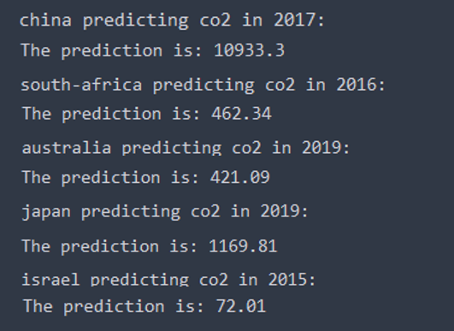
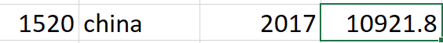
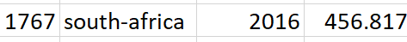
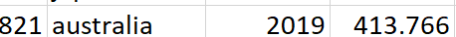
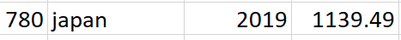
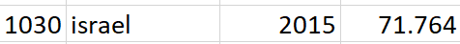
Prediction results
Records from our DataFrame:
Data Acquisition
Data Cleaning
EDA
Machine Learning
Conclusions

Slide 25
Conclusions
Data Acquisition
Data Cleaning
EDA
Machine Learning
Conclusions

Slide 26


